Slide 1
Chapter 2 Intelligent Agents

Slide 2
Outline
Agents and environments
Rationality
Properties of Agents
PEAS (Performance measure, Environment, Actuators, Sensors)
Environment types
Agent types

Slide 3
Agents
Agent is an intelligent system that:
perceives its environment through sensors
acts upon that environment through actuators
Example:
Human agent:
eyes, ears, and other organs for sensors;
hands, legs, mouth, and other body parts for actuators
Robotic agent:
cameras and infrared range finders for sensors;
various motors for actuators

Slide 4
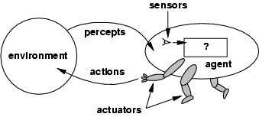
Agents and environments
An agent's choice of action can depend on the entire percept sequence observed to date
An agent's behavior is described by the agent function maps from percept histories to actions: [f: P* → A]
The agent program runs on the physical architecture to produce f
agent = architecture + program

Slide 5
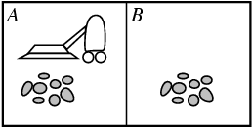
Vacuum-cleaner world
Environment: square A and B
Percepts: location and contents, e.g., [A,Dirty]
Actions: Left, Right, Suck, NoOp

Slide 6

The vacuum-cleaner world
Percept sequence | Action
[A, Clean] | Right
[A, Dirty] | Suck
[B, Clean] | Left
[B, Dirty] | Suck
[A, Clean], [A, Clean] | Right
[A, Clean], [A, Dirty] | Suck
… | …
function REFLEX-VACUUM-AGENT ([location, status]) return an action
if status == Dirty then return Suck
else if location == A then return Right
else if location == B then return Left
What is the right function? Can it be implemented in a small agent program?

Slide 7
Rational agents
A rational agent is one that does the right thing based on what it can perceive and the actions it can perform.
What is the right thing?
Approximation: The right action is the one that will cause the agent to be most successful.
Measure of success?
Performance measure: An objective criterion for success of an agent's behavior
E.g., performance measure of a vacuum-cleaner agent could be amount of dirt cleaned up, amount of time taken, amount of electricity consumed, amount of noise generated, etc.

Slide 8
Rational agents
What is rational at a given time depends on four things:
Performance measure,
Percept sequence to date (sensors),
Prior environment knowledge,
Actions
An Ideal Rational Agent, for each possible percept sequence, should select an action that is expected to maximize its performance measure, given
the evidence provided by the percept sequence
its knowledge, both built-in and acquired

Slide 9
Properties of Agents
Situatedness
has a direct connection to its environment
receives some form of sensory input from its environment
performs some action that changes its environment in some way
Autonomy
can act without direct intervention by humans or other agents
has control over its own actions and internal state.
Decisions must be made independently of the programmer.
Some aspect of the current situation must trigger a response.

Slide 10
Properties of Agents
Adaptivity
reacting flexibly to changes in its environment
taking goal-directed initiative (being pro-active)
learning from its own experience, its environment, and interactions with others
Sociability
interacting in a peer-to-peer manner with other agents or humans
communicating, sharing information
cooperating and/or competing
Rational Agent ⇒ exploration, learning, autonomy

Slide 11
PEAS
To design a rational agent we must specify its task environment.
PEAS:
Performance measure: Goals/desires the agent should try to achieve
Environment: in which the agent exists
Actuators: Actions which may react the environment
Sensors: Percepts/observations of the environment

Slide 12
PEAS Example
Agent: Automated taxi driver
Performance measure: Safe, fast, legal, comfortable trip, maximize profits, ...
Environment: Roads, other traffic, pedestrians, customers
Actuators: Steering wheel, accelerator, brake, signal, horn
Sensors: Cameras, sonar, speedometer, GPS, odometer, engine sensors, keyboard
Agent: Intenet shopping
Performance measure: price, quality, appropriateness, ..
Environment: current and future WWW sites, vendors, shippers
Actuators: display to user, follow URL, fill in form
Sensors: HTML pages (text, graphics, scripts)

Slide 13
PEAS Example
Agent: Medical diagnosis system
Performance measure: Healthy patient, minimize costs, lawsuits.
Environment: Patient, hospital, staff.
Actuators: Screen display (questions, tests, diagnoses, treatments, referrals)
Sensors: Keyboard (entry of symptoms, patient's answers)
Agent: Part-picking robot
Performance measure: Percentage of parts in correct bins
Environment: Conveyor belt with parts, bins.
Actuators: Jointed arm and hand.
Sensors: Camera, joint angle sensors.

Slide 14
PEAS Example
Agent: Interactive English tutor
Performance measure: Maximize student's score on test
Environment: Set of students
Actuators: Screen display (exercises, suggestions, corrections)
Sensors: Keyboard (typed words)
Agent: Chess program
Performance measure: Win game
Environment: Opponent, Game board
Actuators: Next move
Sensors: Current board state

Slide 15
Environment types
Fully observable (vs. partially observable)
An agent's sensors give it access to the complete state of the environment at any point in time.
Noisy and inaccurate sensors can result in partially observable environments.
Deterministic (vs. stochastic)
The next state of the environment is completely determined by the current state and the action executed by the agent.
If the environment is deterministic except for the actions of other agents, then the environment is strategic
Randomness and chance are common causes non-deterministic environments.

Slide 16
Environment types
Episodic (vs. sequential):
The agent's experience is divided into atomic "episodes"
each episode consists of the agent perceiving and then performing a single action
the choice of action in each episode does not depend on the actions in prior episodes.
Games are often sequential requiring one to think ahead.
Static (vs. dynamic):
The environment is unchanged while an agent is deliberating (between the time of perceiving and acting).
The environment is semidynamic if the environment itself does not change with the passage of time but the agent's performance score does
Time is an important factor in dynamic environments, since perceptions can become "stale".

Slide 17
Environment types
Discrete (vs. continuous):
An environment is discrete if there are a limited number of distinct, clearly-defined states of the world which limits range of possible percepts and actions.
Single agent (vs. multiagent):
An environment is multiagent if more than one agents effect the each other's performance.
Multiagent environments can be competitive and/or cooperative.

Slide 18
Environment types
Fully vs. partially observable: an environment is full observable when the sensors can detect all aspects that are relevant to the choice of action.
 | Solitaire | Image-Analysis system | Intenet shopping | Taxi
Observable?? | FULL | FULL | PARTIAL | PARTIAL
Deterministic??
Episodic??
Static??
Discrete??
Single-agent??

Slide 19
Environment types
Deterministic vs. stochastic: if the next environment state is completely determined by the current state and the executed action then the environment is deterministic.
 | Solitaire | Image-Analysis system | Intenet shopping | Taxi
Observable?? | FULL | FULL | PARTIAL | PARTIAL
Deterministic?? | YES | YES | YES | NO
Episodic??
Static??
Discrete??
Single-agent??

Slide 20
Environment types
Episodic vs. sequential: In an episodic environment the agent’s experience can be divided into atomic steps where the agents perceives and then performs a single action. The choice of action depends only on the episode itself
 | Solitaire | Image-Analysis system | Intenet shopping | Taxi
Observable?? | FULL | FULL | PARTIAL | PARTIAL
Deterministic?? | YES | YES | YES | NO
Episodic?? | NO | YES | NO | NO
Static??
Discrete??
Single-agent??

Slide 21
Environment types
Static vs. dynamic: If the environment can change while the agent is choosing an action, the environment is dynamic. Semi-dynamic if the agent’s performance changes even when the environment remains the same.
 | Solitaire | Image-Analysis system | Intenet shopping | Taxi
Observable?? | FULL | FULL | PARTIAL | PARTIAL
Deterministic?? | YES | YES | YES | NO
Episodic?? | NO | YES | NO | NO
Static?? | YES | SEMI | SEMI | NO
Discrete??
Single-agent??

Slide 22
Environment types
Discrete vs. continuous: This distinction can be applied to the state of the environment, the way time is handled and to the percepts/actions of the agent. .
 | Solitaire | Image-Analysis system | Intenet shopping | Taxi
Observable?? | FULL | FULL | PARTIAL | PARTIAL
Deterministic?? | YES | YES | YES | NO
Episodic?? | NO | YES | NO | NO
Static?? | YES | SEMI | SEMI | NO
Discrete?? | YES | NO | YES | NO
Single-agent??

Slide 23
Environment types
Single vs. multi-agent: Does the environment contain other agents who are also maximizing some performance measure that depends on the current agent’s actions?
 | Solitaire | Image-Analysis system | Intenet shopping | Taxi
Observable?? | FULL | FULL | PARTIAL | PARTIAL
Deterministic?? | YES | YES | YES | NO
Episodic?? | NO | YES | NO | NO
Static?? | YES | SEMI | SEMI | NO
Discrete?? | YES | NO | YES | NO
Single-agent?? | YES | NO | NO | NO

Slide 24
Environment types
The environment type largely determines the agent design
The simplest environment is
Fully observable, deterministic, episodic, static, discrete and single-agent.
Most real situations are:
Partially observable, stochastic, sequential, dynamic, continuous and multi-agent.

Slide 25
Agent types
Four basic types in order of increasing generality:
Simple reflex agents
lookup table
if-then rules
Model-based reflex agents
Goal-based agents
Utility-based agents
All these can be turned into learning agents.

Slide 26
Agent types: Simple Table-Based Reflex
use a table lookup where each percept is matched to an action
Problems/Limitations?
table may be too big to generate and store
not adaptive to changes in the environment; instead table must be updated
can't make actions conditional
reacts only to current percept; no history kept

Slide 27
Table-lookup agent
Function TABLE-DRIVEN_AGENT(percept) returns an action
static: percepts, a sequence initially empty
table, a table of actions, indexed by percept sequence
append percept to the end of percepts
action ← LOOKUP(percepts, table)
return action
Drawbacks:
Huge table
Take a long time to build the table
No autonomy
Even with learning, need a long time to learn the table entries

Slide 28
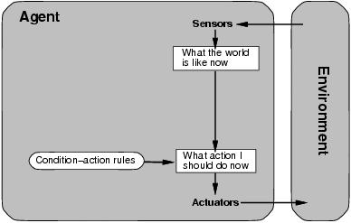
Agent types: Simple Rule-Based Reflex
Select action on the basis of only the current percept.
No need to consider all percepts
Implemented through condition-action rules
If dirty then suck
Can adapt to changes in the environment by adding rules
Problems/Limitations?
reacts only to current percept; no knowledge of non-perceptual parts of the current state

Slide 29
The vacuum-cleaner world
function REFLEX-VACUUM-AGENT ([location, status]) return an action
if status == Dirty then return Suck
else if location == A then return Right
else if location == B then return Left

Slide 30
Agent types; simple reflex
function SIMPLE-REFLEX-AGENT(percept) returns an action
static: rules, a set of condition-action rules
state ← INTERPRET-INPUT(percept)
rule ← RULE-MATCH(state, rule)
action ← RULE-ACTION[rule]
return action
Will only work if the environment is fully observable otherwise infinite loops may occur.

Slide 31
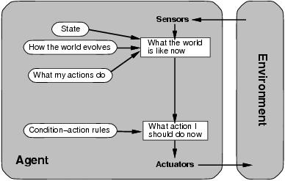
Agent types; reflex and state
To tackle partially observable environments.
Maintain internal state
Over time update state using world knowledge
How does the world change.
How do actions affect world.
Model of World
Problems/Limitations?
not deliberative, agent types so far are reactive

Slide 32
Agent types; reflex and state
function REFLEX-AGENT-WITH-STATE(percept) returns an action
static: rules, a set of condition-action rules
state, a description of the current world state
action, the most recent action.
state ← UPDATE-STATE(state, action, percept)
rule ← RULE-MATCH(state, rule)
action ← RULE-ACTION[rule]
return action

Slide 33
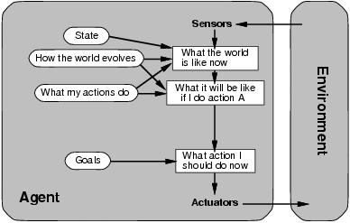
Agent types; goal-based
Chose actions to achieve a desired goal
Search or planning often used
Problems/Limitations?
May have to consider long sequences of possible actions before goal is achieved
Involves consideration of the future, “What will happen if I do...?”
How are competing goals treated?
What about degrees of success?

Slide 34
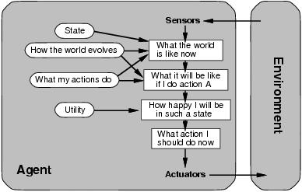
Agent types; utility-based
Achieve goals while trying to maximize some utility value
Utility value gives a measure of success or "happiness" for a given situation
Allows decisions comparing choice between
Conflicting goals
Likelihood of success and importance of goal

Slide 35
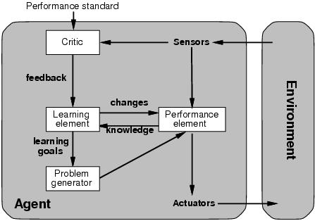
Agent types; learning
Learning mechanisms can be used to perform this task.
Teach them instead of instructing them.
Advantage is the robustness of the program toward initially unknown environments.

Slide 36
Agent types; learning
Learning element:
Introduce improvements in performance element.
Critic provides feedback on agents performance based on fixed performance standard.
Performance element:
Selecting actions based on percepts.
Problem generator:
Suggests actions that will lead to new and informative experiences.
Exploration vs. exploitation

Slide 37
Sumary
Agents interact with environments through actuators and sensors
The agent function describes what the agent does in all circumstances
The performance measure evaluates the environment sequence
A perfectly rational agent maximizes expected performance
Agent programs implement (some) agent functions
PEAS descriptions dene task environments
Environments are categorized along several dimensions:
observable? deterministic? episodic? static? discrete? single-agent?
Several basic agent architectures exist:
reflex, reflex with state, goal-based, utility-based

